Slide 1
Required programs
Massachusetts OSHA State Plan
Department of Labor Standards
Workplace Safety & Health Program for Public Employees
WSHP Webinar Series
April 5, 2023

Slide 2
Objectives
Introduction
Review Required Programs for DPW Highways.
Today’s Speaker:
Bruce Fletcher.
Industrial Health and Safety Inspector
Bruce.fletcher@mass.gov
MA DLS – WSHP
Massachusetts State Plan
508-967-9943
safepublicworkplacemailbox@mass.gov

Slide 4
EAP – Emergency Action Plan
Reporting protocols for any emergency;
Names and/or titles of individuals who should be alerted;
Assignments of escape routes and step-by-step procedures for evacuation;
Medical and rescue procedures to be used by appointed employees;
Confirmation that all personnel are present following an evacuation; and
Steps to be taken by those on your staff who will stay behind to complete critical work prior to evacuation

Slide 5
BBP- Blood Borne Pathogen

Slide 6
BBP- Blood Borne Pathogen
Implement a written exposure control plan for the worksite with details on employee protection measures
Update the plan annually to reflect changes in tasks, procedures, and positions that affect occupational exposure
Identify and use engineering controls
Identify and ensure the use of work practice controls
Provide personal protective equipment (PPE), such as gloves, gowns, eye protection, and masks
Make available hepatitis B vaccinations to all workers with occupational exposure
Use labels and signs to communicate hazards
Provide information and training to workers
Maintain worker medical and training records

Slide 7
Record Keeping – OSHA 300 Log
Death - report to OSHA within 8 hours
Hospitalization - work-related, report to OSHA within 8 hours
Amputation - report to OSHA within 24 hours
Loss of an Eye - report to OSHA within 24 hours
Medical treatment beyond first aid
Loss of Consciousness
Days away from work
Restricted work or transfer to another job (due to injury or illness)

Slide 8
PPE Hazard Assessment
Assess the workplace to determine if hazards are present which necessitate the use of PPE
Prepare, sign, and date a "Certification of Hazard Assessment"
Select and issue the appropriate PPE at no cost to employees
Train employees about the following items:
when the PPE is necessary
what PPE is necessary
how to properly don, doff, adjust and wear the PPE
limitations of the PPE
proper care, maintenance, useful life and disposal of the PPE

Slide 9
HAZCOM – Hazardous Communications
Employees must be made aware of any operations in their work area where hazardous chemicals are present, and the location and availability of the written hazard communication program, including the required list(s) of hazardous chemicals, and SDSs.
Training must include at least:
How employees can protect themselves from these hazards, including specific procedures in place to protect employees from exposure to hazardous chemicals, such as work practices, emergency procedures, and personal protective equipment (PPE) to be used; and
.

Slide 10
HAZCOM – Hazardous Communications
The details of the hazard communication program, including an explanation of the labels received on shipped containers and the workplace labeling system used by their employer; and the SDS, including the order of information and how employees can obtain and use the appropriate hazard information

Slide 11
LOTO – Lock out Tag out
Identify the equipment/ machinery that require LOTO
Identify your Authorized employees
Identify your Affected employees
Create LOTO SOP for each piece of equipment identifying the operating controls and the energy sources
Train all Authorized and Affected employees

Slide 12
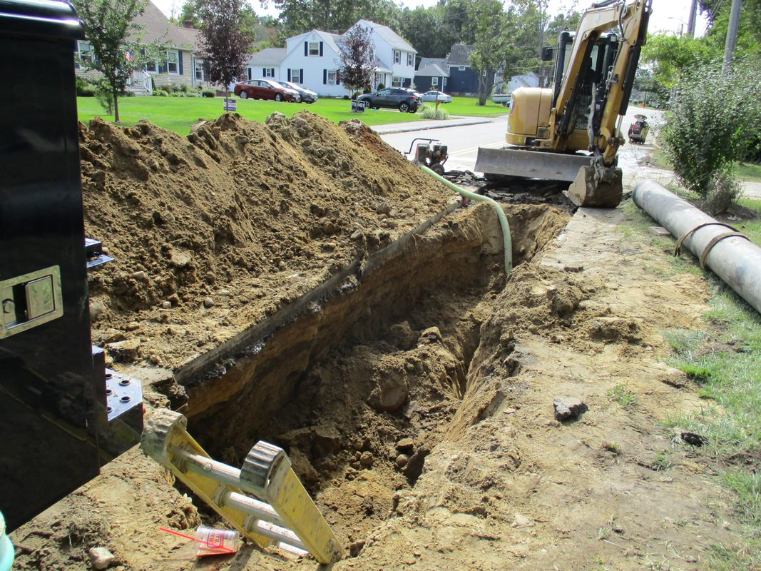
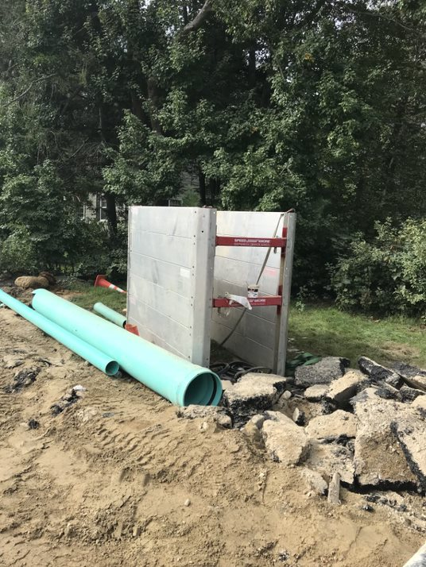
Trench Safety
Notes:
The employer is responsible for protecting employees from cave-in at excavation sites. The employer must ensure that a daily inspection is conducted by a designated Competent Person who has completed training to identify excavation hazards, and has authority to stop work and make corrections. The employer must provide training to employees, and ensure that cave-in protection systems are provided when required.

Slide 13
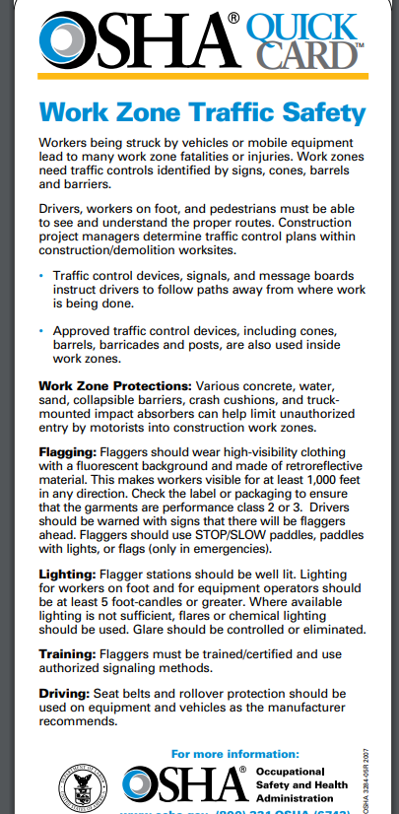
Work Zone Safety
Notes:
Follow the MUTCDWork zones need traffic controls identified by signs, cones, barrels and barriers. Drivers, workers on foot, and pedestrians must be able to see and understand the proper routes. Construction project managers determine traffic control plans within construction/demolition worksites.

Slide 14
Other Programs to Consider
Confine Space
Respiratory Program
Fire prevention
Fire Extinguishers
Ariel Lifts

Slide 15
OSHA Consultation
Free Consultation is available from staff who are separate from the enforcement team.
Employer is required to provide proof of correction before due date.
Findings are NOT used as first strike to issue penalties.
Consultation reports are kept confidential. A firewall does not allow Enforcement staff to see where Consultation has been or see reports.

Slide 16
Contact Us
Workplace Safety and Health Program
Phone: 508-616-0461 x1
Email: safepublicworkplacemailbox@mass.gov
Website: www.mass.gov/dols/wshp

