Slide 1
NBM Spring Tech Meeting CDL Training Program Franklin Department of Public Works
April 5th, 2023
Brutus Cantoreggi, Director
rcantoreggi@franklinma.gov
(508) 520-4910
tpr.fmcsa.dot.gov

Slide 2
History
United States Department of Transportation adopts new rules and requirements to obtain Commercial Driver's License (CDL)--Feb 2022
What is Entry-Level Driver Training?
The ELDT regulations set the minimum Federal requirements for training that entry-level drivers must complete before being permitted to take certain CDL skills or knowledge tests.

Slide 3
What Did Franklin Do???
Complained
Commensurate with peers
Reached out to Federal Representatives and Senators
Did some research on requirements…….

Slide 4
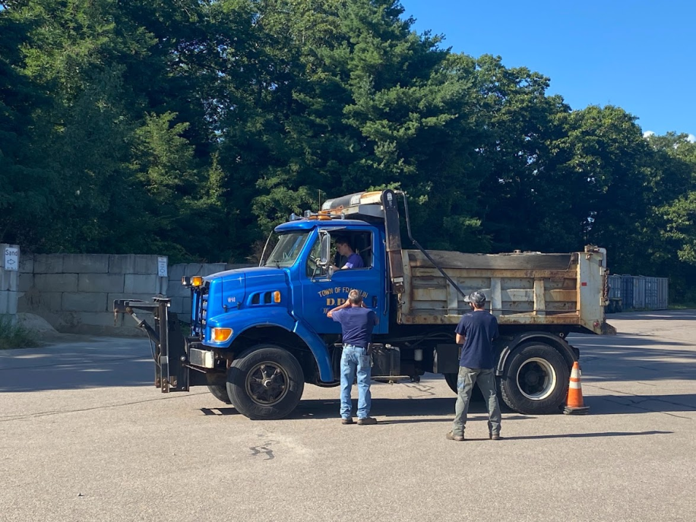
What Did Franklin Do???
Became a registered training provider !!!
Appointed an Administrator
Established a program
Training (10 hours)
Circle Check (3 hours)
Air Brakes (3 hours)
Road time (10 hours)
Log sheets
Written Test

Slide 5
What Did Franklin Do???
Negotiated with Union
“Buy in”
Stipends
Pay

Slide 6
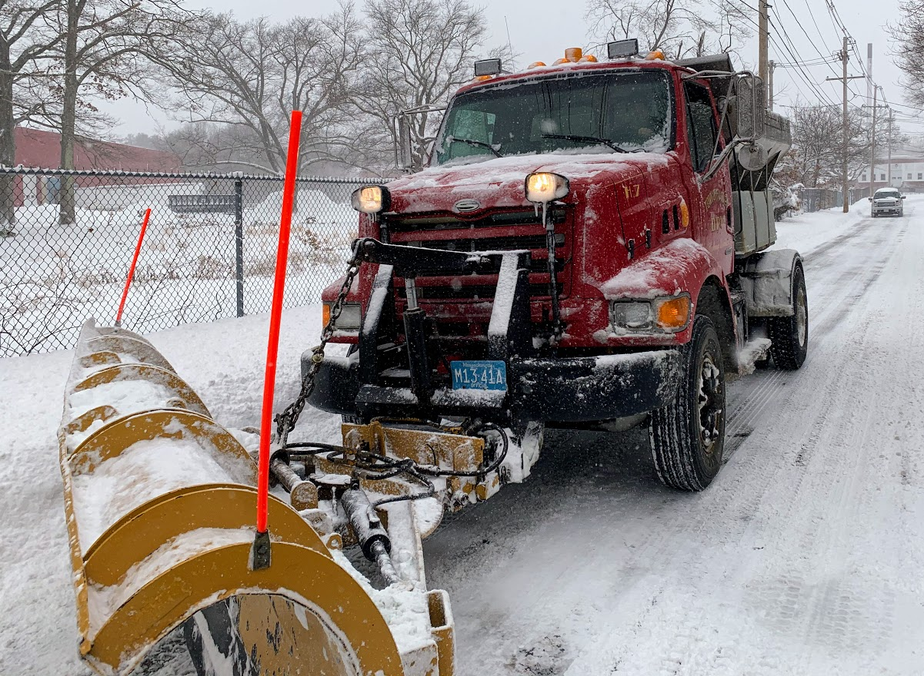
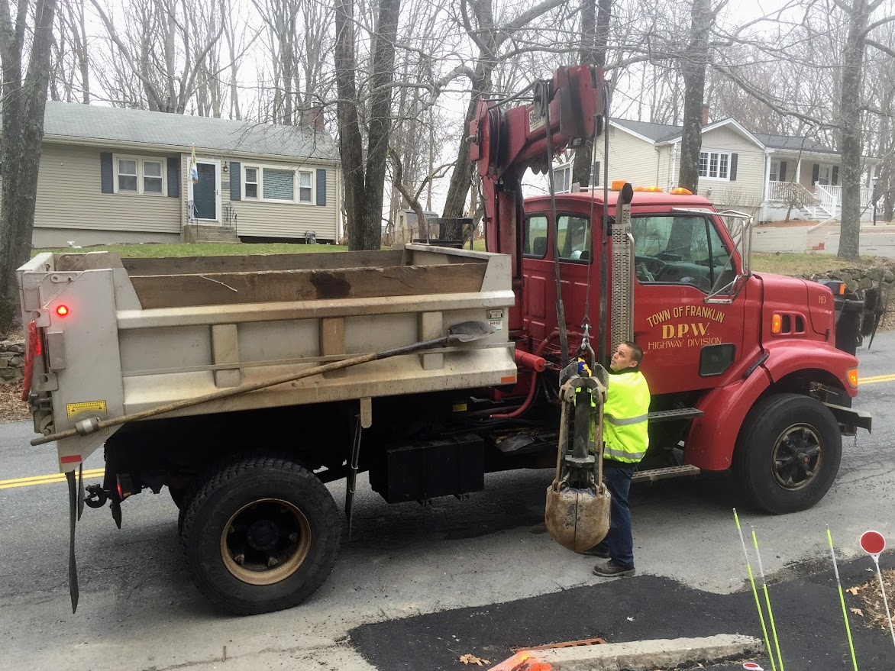
Time Table
Town became registered trainer–April 2022
Negotiated with Union–June 2022
Started training–August 2022
First employee passed our curriculum–Sept. 2022
Mass RMV recognized Town as trainer, allowed employee to take road test–October 2022
Employee took driving test–November 2022

Slide 7
Instructors
Theory instructors must:
Hold a CDL of the same (or higher) class, and with all endorsements necessary, to operate the commercial motor vehicle (CMV) for which training is to be provided.
Meet all applicable State qualification requirements for CMV instructors. (Exception: This is not required if providing theory instruction exclusively.)
Meet one of these:
Have a minimum of two years experience operating a CMV requiring a CDL of the same (or higher) class, or the same endorsement; or
Have previously held a CDL of the same (or higher) class; or
Have a minimum of two years experience as a BTW CMV instructor.
Behind-the-Wheel (BTW) instructors must:
Hold a CDL of the same (or higher) class, and with all endorsements necessary, to operate the CMV for which training is to be provided.
Meet all applicable State qualification requirements for CMV instructors.
Meet one of these:
Have a minimum of two years experience operating a CMV requiring a CDL of the same (or higher) class, or the same endorsement; or
Have a minimum of two years experience as a BTW CMV instructor.

Slide 8
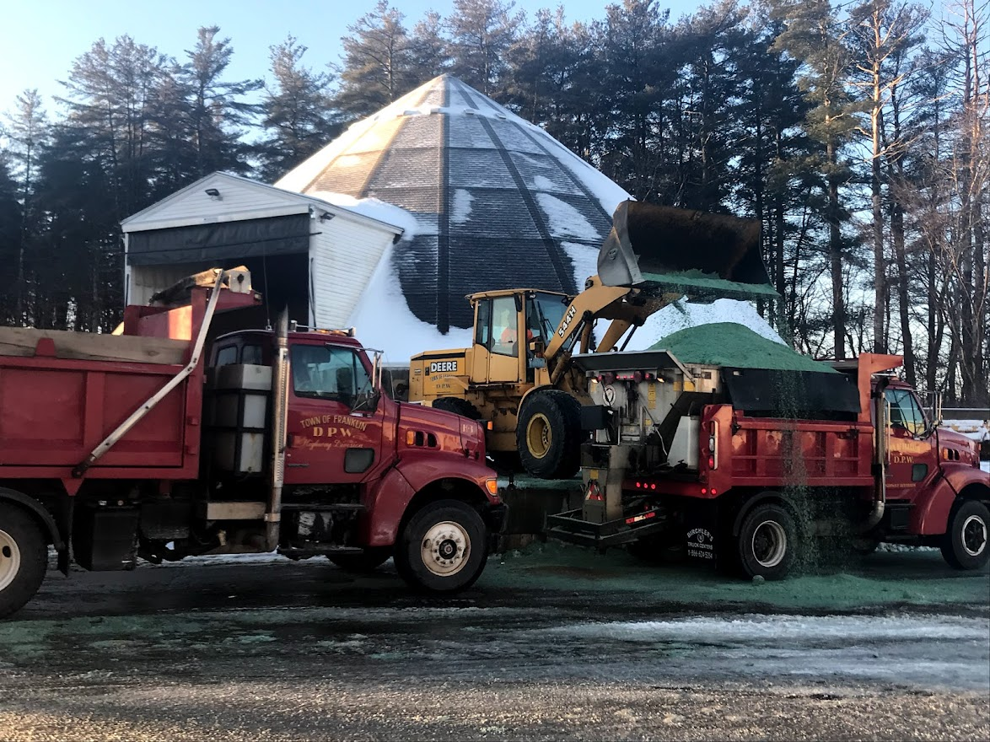
Estimated Costs
Trainer: $1500.00(OT)
Stipend: $1000.00
Employee: $0
$2500.00

Slide 9
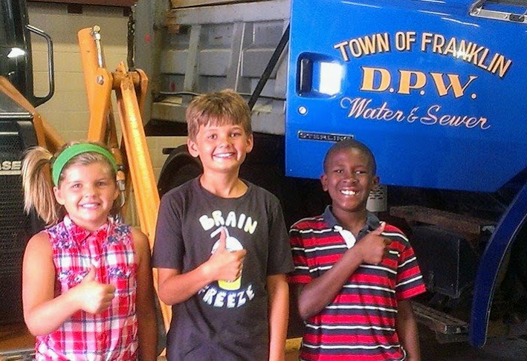
Going Forward
Train employees from outside your organization???
Become a recognized trainer yourself!!!
Questions???

