Slide 1
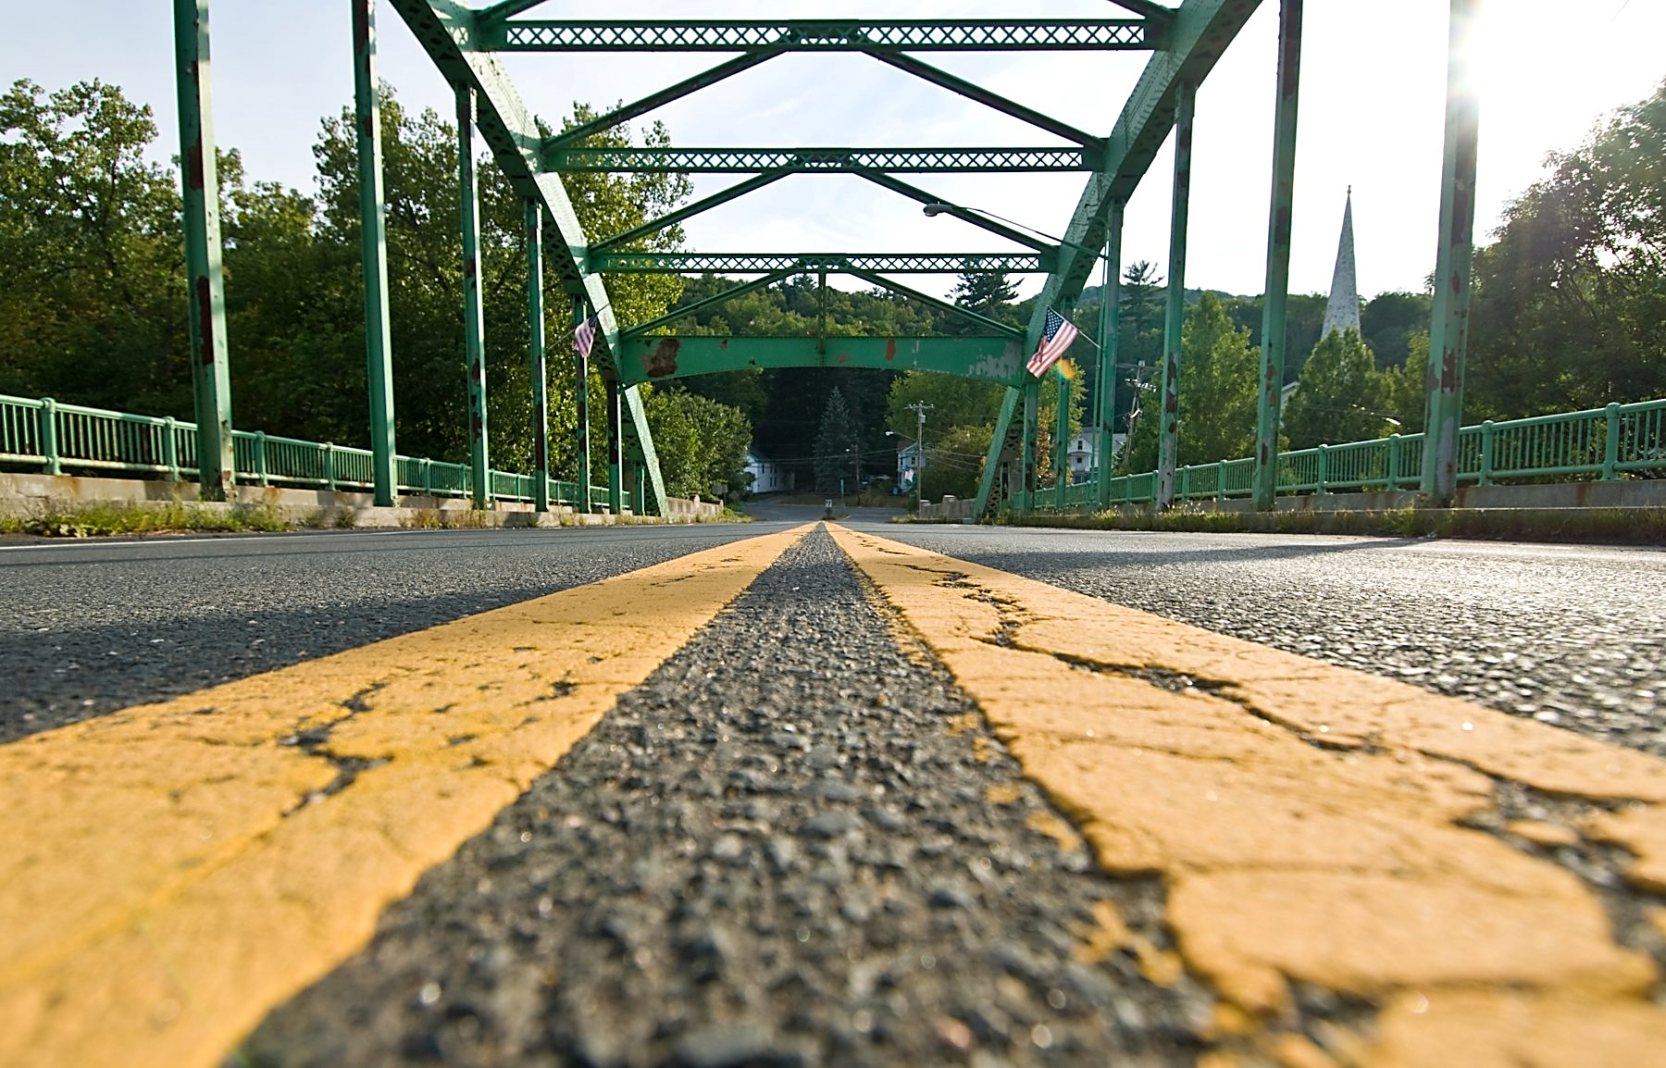
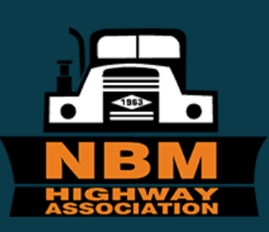
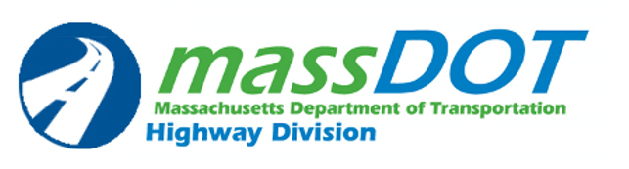
NBM 2023 Spring Technical Session
John J. Bechard, P.E.
Deputy Chief Engineer for Project Development
April 5, 2023

Slide 2

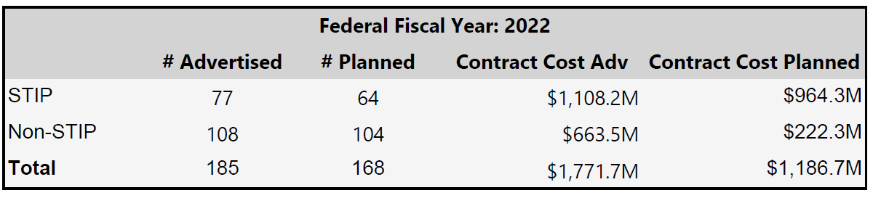
FY 2022 In Review (10/1/21--9/30/22)
Successful Delivery of FFY 2022 advertisement program with 185 total projects advertised, continued roll-out of process improvements expediting overall project delivery
On-time performance by Project Manager was 86.7% within 30 days of locked down AD dates (based on original 168 programmed projects)
Total program advertised - $1,771Bil. (largest ever)

Slide 3
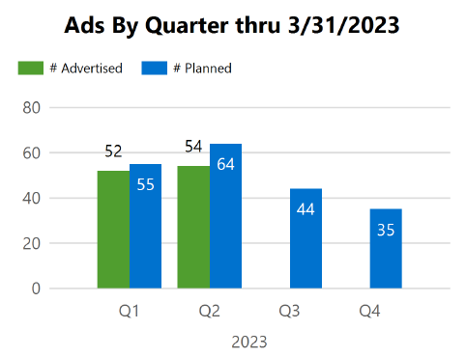
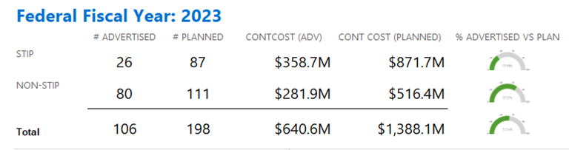
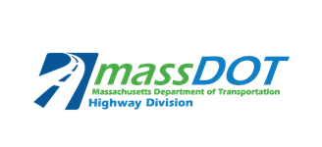
2023 Advertisement Program Update
198 Planned Advertisements for FFY22, 87 Fed Aid, 111 NFA
Notes:
We have 197 Planned Advertisements for 2023 with 87 of them Federal Aid funded

Slide 4
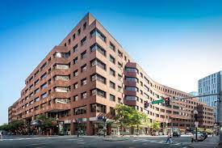
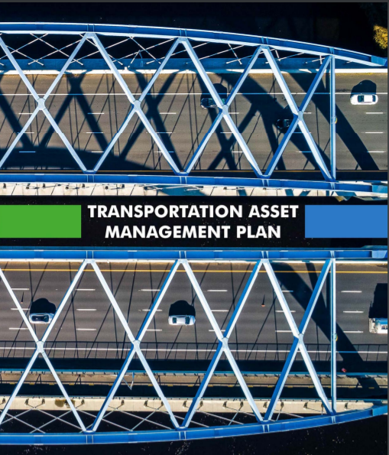
Looking Forward to 2023 and Beyond
Increasing federal funding through the Infrastructure Investment and Jobs Act (IIJA) also known as the Bipartisan Infrastructure Law (BIL)
Future of work becoming our way of doing business
  Implementing hybrid and flexible schedules and significant progress in modernization of Boston Transportation Building and District Offices
Submitting first update to Federal Transportation Asset Management Plan (TAMP) since its initial report in 2019

Slide 5
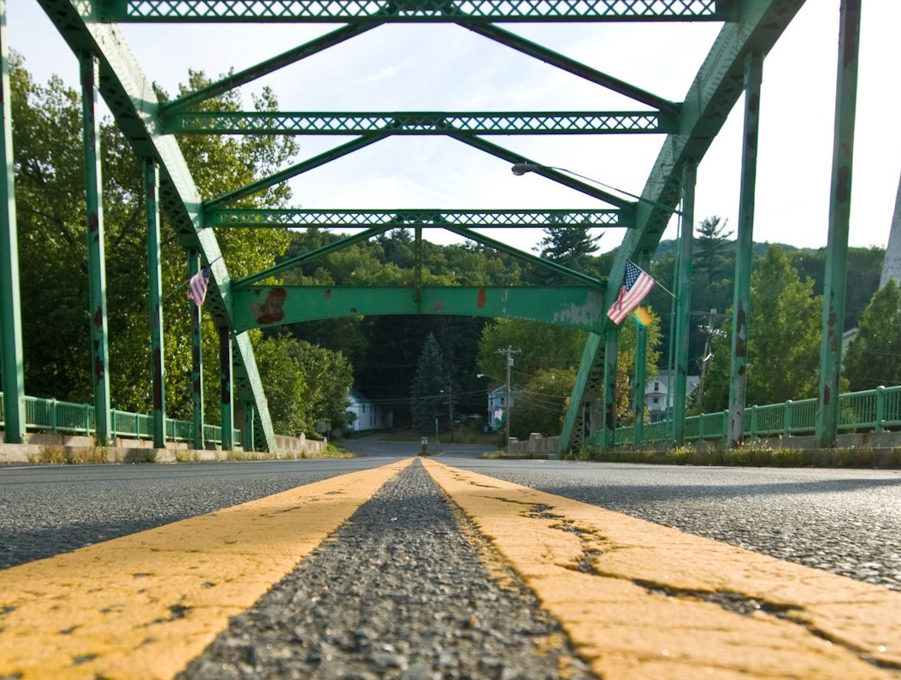
Expanded Bridge Program
Massachusetts received sixth largest state allocation of bridge formula funds through BIL
NextGen provided MassDOT a head start for BIL
On-going scoping of new bridge projects
Significant increase in maintenance & preservation projects
Image source: MassDOT
Notes:
Massachusetts received sixth largest state allocation of bridge formula funds through BIL
Next Gen provided MassDOT a head start for BIL
preliminary advertisement dates developed for 65 bridge projects
Includes 40 newly initiated projects (proposals for 25% design in process)
Scoping of additional round of new projects planned for spring
In addition to rehab/replacement, significant increase in maintenance & preservation projects

Slide 6
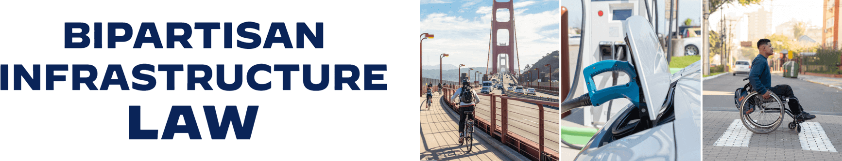
Bipartisan Infrastructure Law (BIL)
A total of $5.4B in highway formula funds and over $110B in possible discretionary grants​
The Bipartisan Infrastructure Law primarily provides for the five-year reauthorization of the surface transportation federal funding programs for highway and transit​
BIL also includes over $110B in discretionary grant programs that MassDOT will aggressively pursue based on grant criteria, project eligibility and formal guidance from our federal partners (FHWA and FTA)

Slide 7
Preparing for the Bipartisan Infrastructure Law - Process
Workstream | Goal
Traffic Control | Reduce reliance on MSP for construction details by relying on alternatives to details and/or other interventions.
Risk Based Design & Review | Evaluate and streamline (identify, analyze and prioritize) risk with design process and review and establish processes /tools to decrease the overall design duration.
Environmental | Streamline the ENV review process to help reduce duration of environmental permitting to ensure on time project Advertisement. Development of a performance management dashboard.
Right of Way | Top to bottom review of ROW process with identification of bottlenecks and solutions to help reduce ROW duration to ensure on time project Advertisement. Development of a performance management dashboard.
District Bridge Maintenance Contracting | Improve the Consistency of District Bridge Maintenance Contracting to support funding increase and streamline and improve contract execution
Alternative Project Delivery | Top to bottom review of the program processes to identify bottlenecks and improvements needed to improve velocity of projects which may include program enhancements and policy changes.
Notes:
Next Steps:
Commence phase 2 - 01/24/22
Internal Solutions
External solutions
^from ACEC 1.20.22 slide deck

Slide 8
Municipal Funding Programs
Overview of MassDOT Highway Division funding programs:
  Chapter 90 Program
  Complete Streets Funding Program
  Local Bottleneck Reduction Program
  Municipal Pavement Program
  Municipal Small Bridge Program
  Shared Streets and Spaces Program
  Winter Recovery Assistance Program (WRAP)

Slide 9
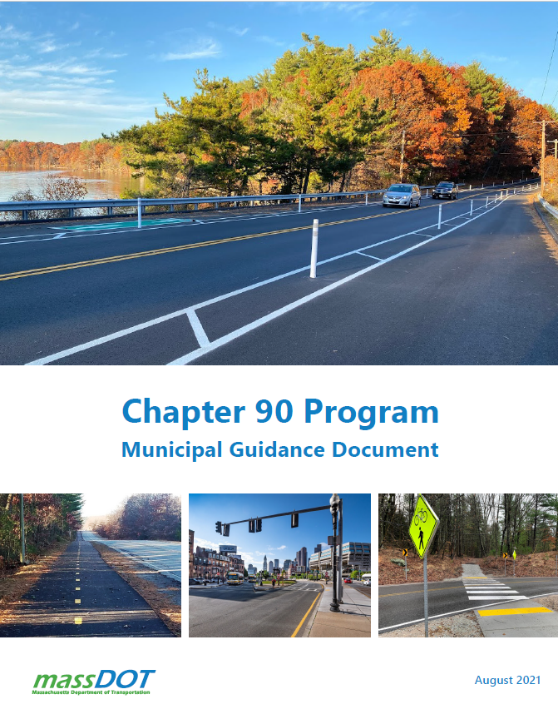
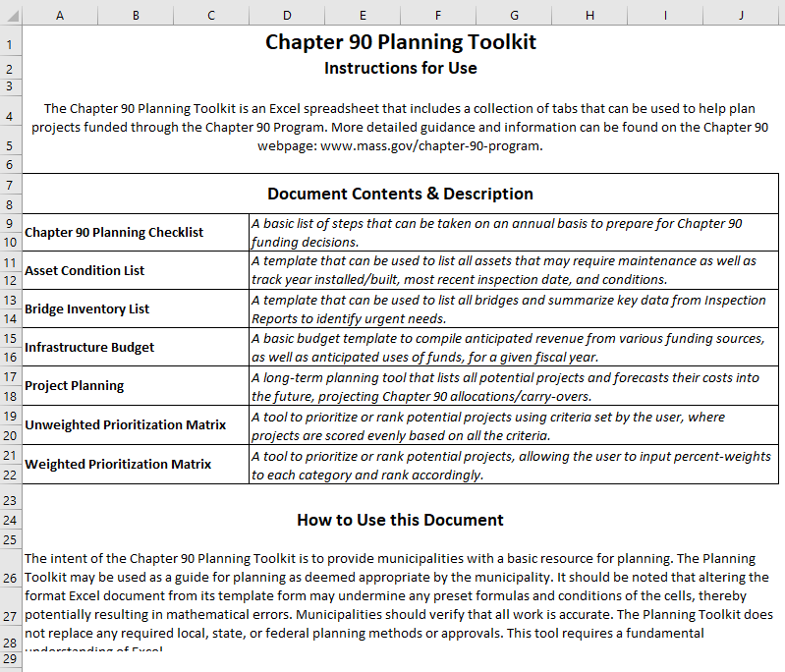
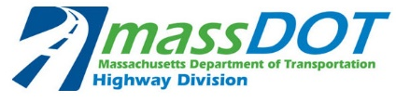
Chapter 90 Program
Chapter 90 entitles cities and towns to reimbursements on transportation projects
  Formula-based apportionments determined by lane miles, population, and employment
New Guidance Document released in 2021
  New and clarified information all in one place
  Supports local decision-making and investment planning with new tools:
    Quick-Start Guide
    Planning Toolkit

Slide 10
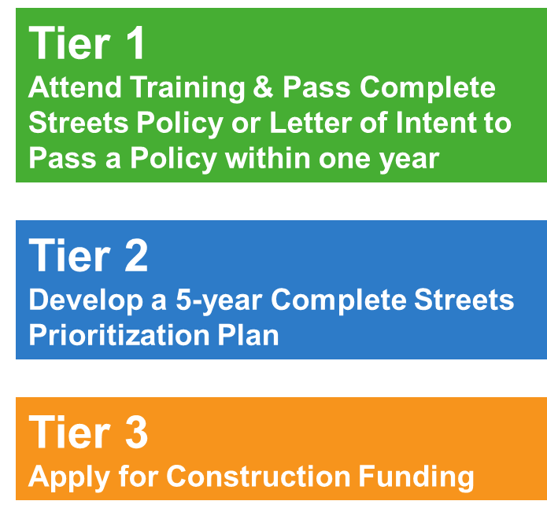
Complete Streets Funding Program
Encourages communities to incorporate Complete Streets principles into regular local planning and design practices
  Safe and accessible travel for all roadway users regardless of age or ability
  Projects include sidewalks, bike lanes, paths, curb extensions, and more!
Provides technical assistance and project funds to incentivize ongoing change
  Tier 2 Technical Assistance grants: up to $38K
  Tier 3 Project grants: up to $500K (competitive application process)
    Design funded separately by municipality
Notes:
Design is not eligible.

Slide 11
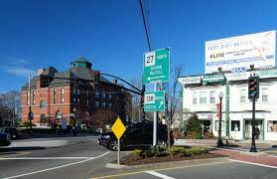
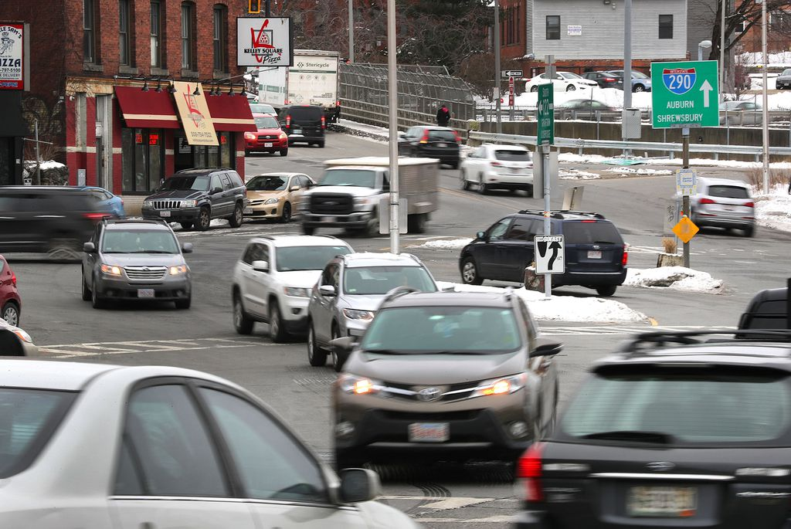
Local Bottleneck Reduction Program
Funds solutions to address local congestion bottlenecks to improve traffic flow and safety
Competitive application program provides up to $500,000 in construction funding
  Project design is completed at no cost by a MassDOT-led consultant
Eligible project types include:
  Addition of turn/through/auxiliary lanes
  Geometric changes to the roadway
  Improved pavement markings or signage
  New signal equipment or improvements such as coordination

Slide 12
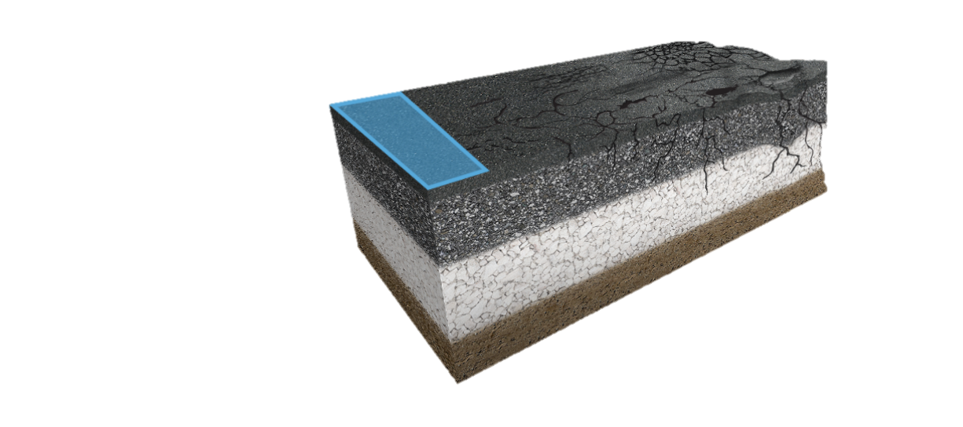
Municipal Pavement Program
Seeks to improve the condition of municipally-owned state numbered routes
  Projects include resurfacing, mill and overlay, and similar
Not a competitive application program
MassDOT selects roadway segments based on:
  Pavement condition data
  Locally owned state route mileage in a municipality
  Geographic equity
Funds as many segments as possible in a given year
  Project value depends on necessary roadway treatments
Design and construction managed by MassDOT and its contractor in coordination with community

Slide 13
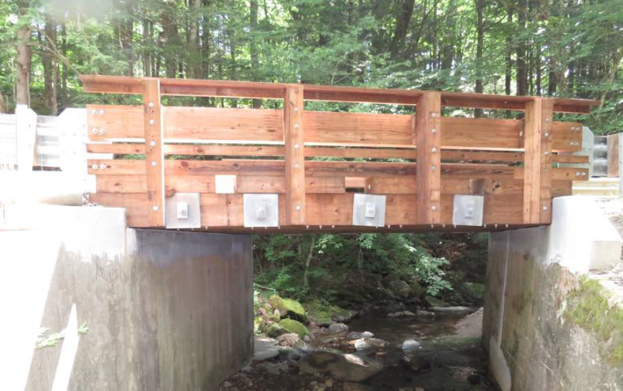
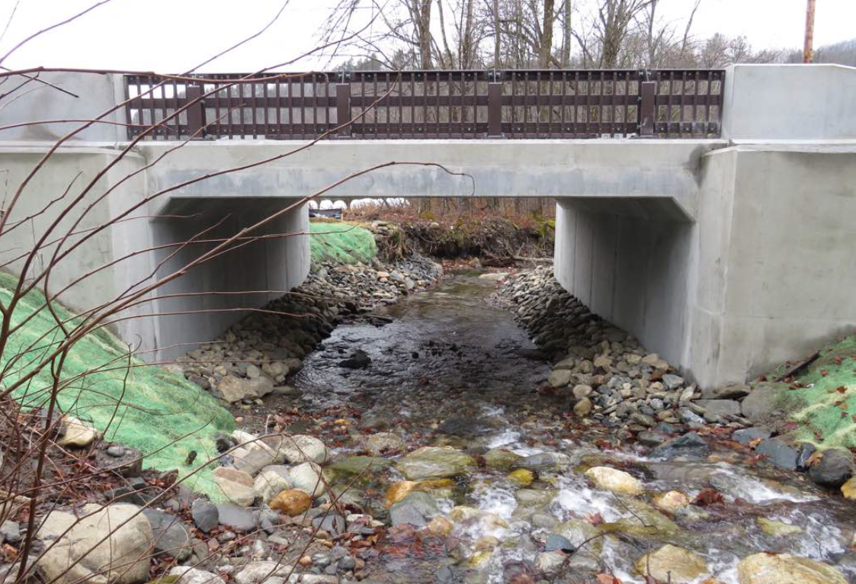
Municipal Small Bridge Program
Provides cities and towns with financial support for small bridge replacement, preservation, and rehabilitation projects
  Bridges must be municipally owned on public ways with spans between 10' and 20’
FY23: program utilizes competitive phased grants:
  Phase 1: design conducted by MassDOT led consultant at no cost, or a grant up to $100k
  Phase 2: construction up to $500K

Slide 14
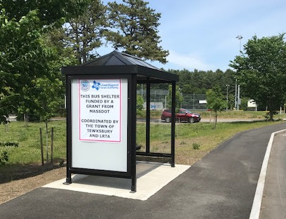
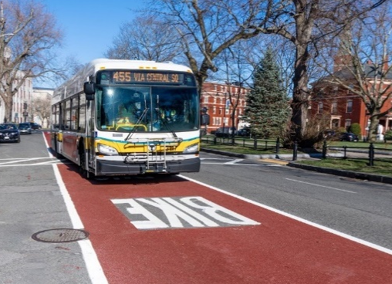
Shared Streets and Spaces Program
Quick-build projects that support public health, safe mobility, and renewed commerce
First launched as a response to COVID-19 then continued due to local success
Competitive application program
Eligible projects include permanent or pilot:
  Sidewalks, paths, bicycle facilities, outdoor dining/programming equipment, traffic calming, and bus lane or bus stop improvements
  Grant limits vary between $200K and $500K
Seeks to encourage communities to get creative
Progress of FY23 awards (184 grants!) will inform next round’s timing

Slide 15
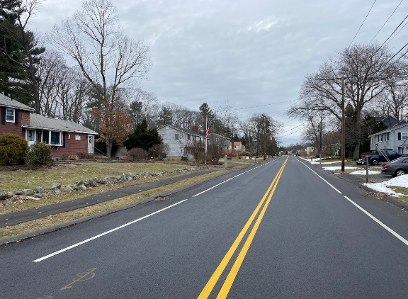
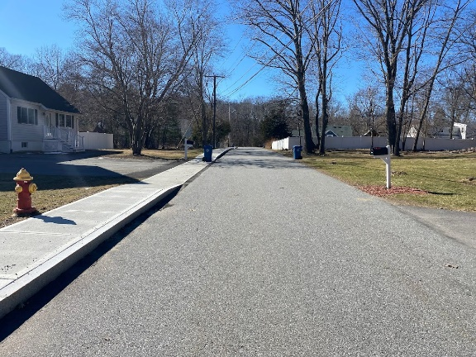
WRAP Funding
In April 2022, Governor Baker approved $100M in funding for the Winter Recovery Assistance Program (WRAP)
Funding is distributed to every community via a formula based on a municipality's share of locally owned roadway mileage
Funds must be spent by June 30, 2023
Eligible project types:
  Rehabilitation, reconstruction, resurfacing or preservation of roadways and appurtenances
  Including sidewalks and bike lanes/paths
  Repair or replacement of traffic control devices, signage, guardrails, and storm grates
  Road striping or painting

Slide 16
Municipal Funding Program Updates
Chapter 90 Program
  Apportionment letters for FY24 mailed out in February, also listed on Chapter 90 website.
Complete Streets Funding Program
  FY24 grant round #1 applications due May 1. Expect to hear around June.
Local Bottleneck Reduction Program
  FY24 grant round application deadline was March 31, Expect to hear around July.
Municipal Pavement Program
  Hope to talk w/municipalities selected for FY24 program year this Spring.
  Currently working through implementation of FY23 projects.
Municipal Small Bridge Program
  New grant round opening May 1, closing June 30. No program changes.
Shared Streets and Spaces Program
  Planning another grant round in FY24, but no date available at this time.
Winter Recovery Assistance Program (WRAP)
  98% of communities under contract with MassDOT for these funds – keep spending!
  Funds no longer available after June 30 this year.

Slide 17
Municipal Program Web-sites
Do you have questions?
Each program presented today has a website and program guidance:
  Chapter 90 Program - www.mass.gov/chapter-90-program
  Complete Streets Funding Program - gis.massdot.state.ma.us/completestreets/
  Local Bottleneck Reduction Program - www.mass.gov/local-bottleneck-reduction-program
  Municipal Pavement Program - www.mass.gov/municipal-pavement-program
  Municipal Small Bridge Program - www.mass.gov/municipal-small-bridge-program
  Shared Streets & Spaces - www.mass.gov/shared-streets-and-spaces-grant-program
  WRAP - www.mass.gov/winter-recovery-assistance-program-wrap

Slide 18
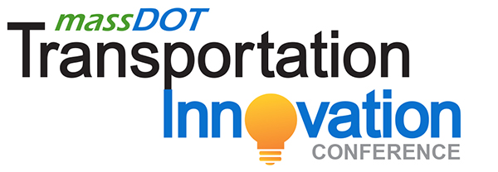
MassDOT Innovation Conference May 2-3, 2023
DCU Center, Worcester, MA in person with virtual (limited sessions) attendance option open until 5/2
Register Today at MassDOTInnovation.com
The annual MassDOT Transportation Innovation Conference provides a forum for innovative transportation systems, management ideas, and initiatives. A specific focus of this year’s conference will be on MassDOT’s investment in infrastructure. More session details coming soon!
This year's session topics will include:
• Beyond Mobility
• United for ALICE Project (Asset Limited, Income Constrained, Employed)
• Streets and Safety
• Implementation of Agile Methods at MassDOT’s Highway Division
• Big Bridges Require Unique Solutions

Slide 19
MassDOT’s Annual Municipal Award Program Seeks Nominations by April 14th
The Municipal Award Program is open to communities and consultant/contractor teams. Submissions under each category will be judged on how well a project incorporates MassDOT’s core values of safety, reliability, accessibility, sustainability, and equity.
Consideration will also be given to how the project employs an innovative application of best practices or evolving new technical solutions; and how the project provides a future benefit to the Commonwealth’s other communities as they address their own transportation challenges or to the industry as a whole.
Please use the link below to submit a project. Deadline for submitting a project is no later than 5pm on Friday, April 14th.
Municipal Award Nomination Form https://www.umasstransportationcenter.org/Forms.asp?MODE=NEW&Forms_FormTypeID=-99

Slide 20
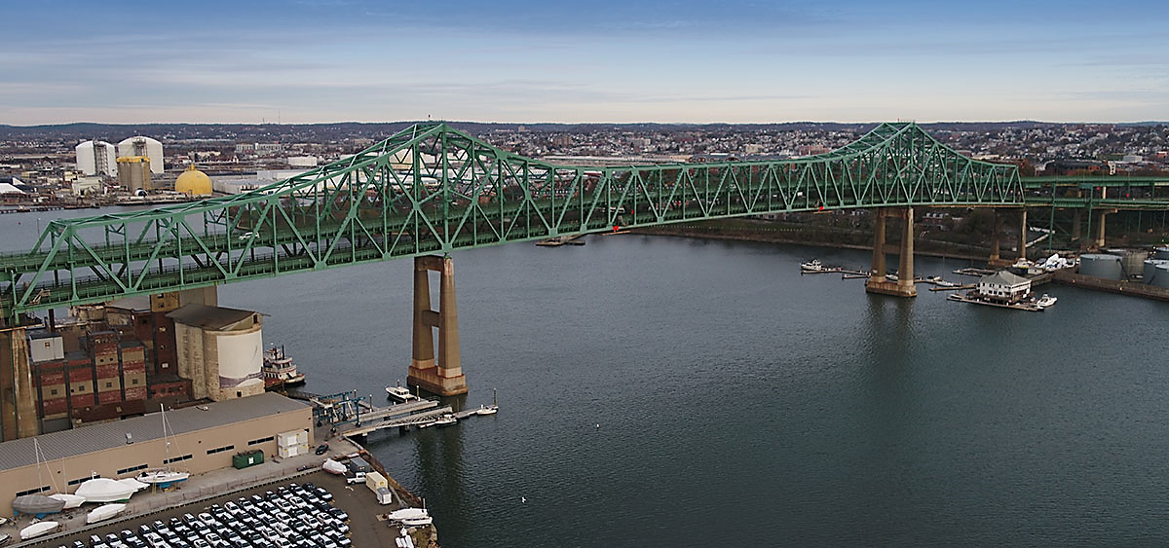
Thank you
Contact information
John J. Bechard, P.E. Deputy Chief Engineer for Project Development
John.Bechard@dot.state.ma.us

Slide 21
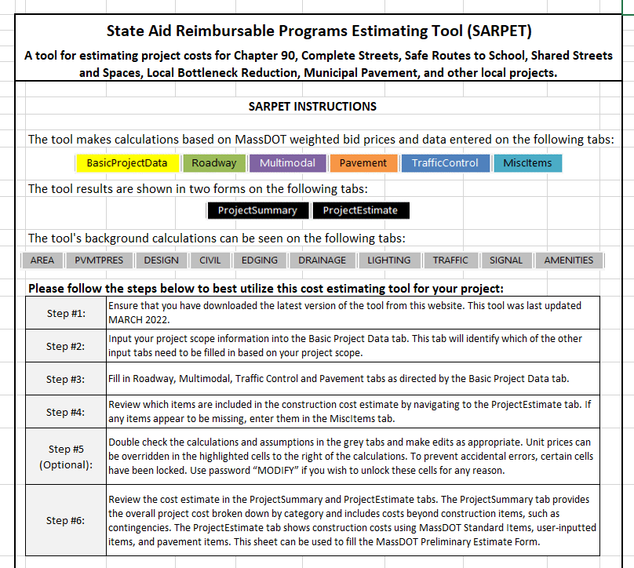
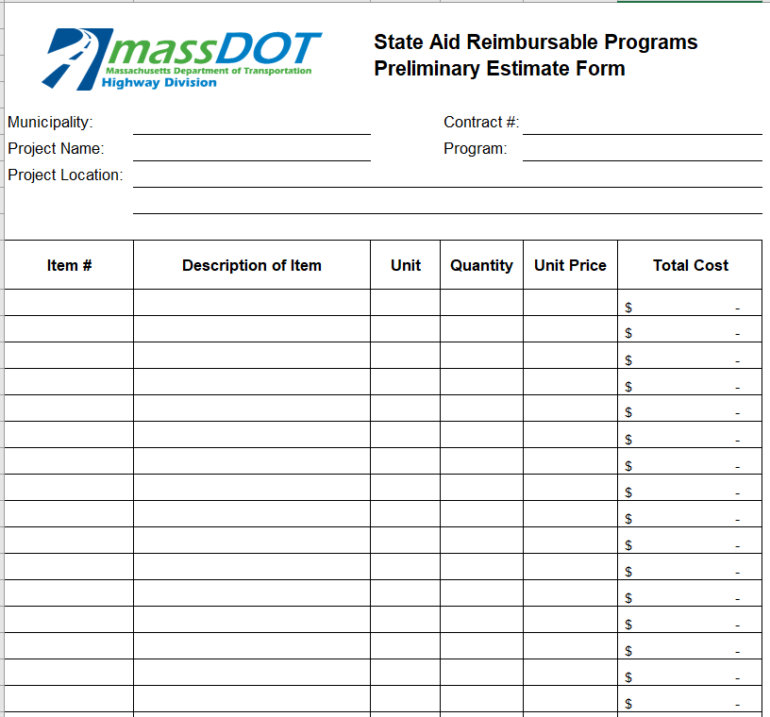
What is SARPET?
The State Aid Reimbursable Programs Estimating Tool (SARPET) is an excel document that provides municipal staff with a reliable and easy method to develop cost estimates

Slide 22
Why SARPET?
Before SARPET, no state-wide cost estimation tool existed for local transportation projects
Project cost development can be difficult, time consuming, and sometimes expensive
Cost estimates are generally required for project funding applications for MassDOT programs
Inaccurate cost estimates lead to budget and implementation issues down the road

Slide 23




SARPET Overview
SARPET can calculate project costs for projects that include various components:
  Roadway
  Multimodal
  Traffic control
  Pavement
Includes a broad range of project elements from pavement resurfacing to bicycle racks to lighting
  Miscellaneous items can also be added

Slide 24

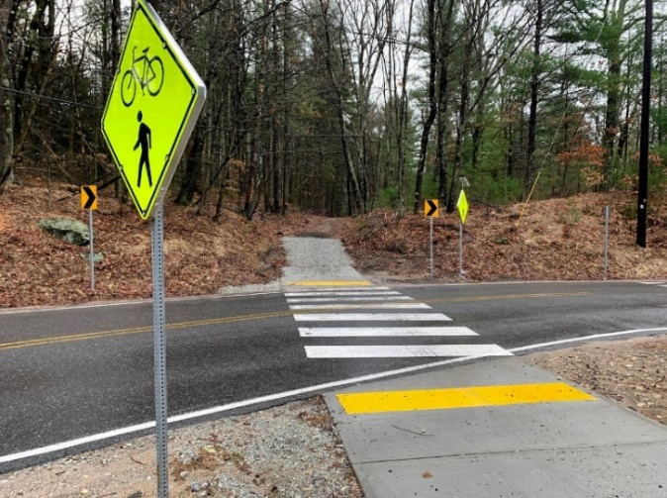
SARPET Overview: Uses
Supports project applications submitted through MassDOT’s funding programs, such as:
  Chapter 90
  Complete Streets
  Safe Routes to School
  Shared Streets & Spaces
Can also be used for projects funded through other sources

Slide 25
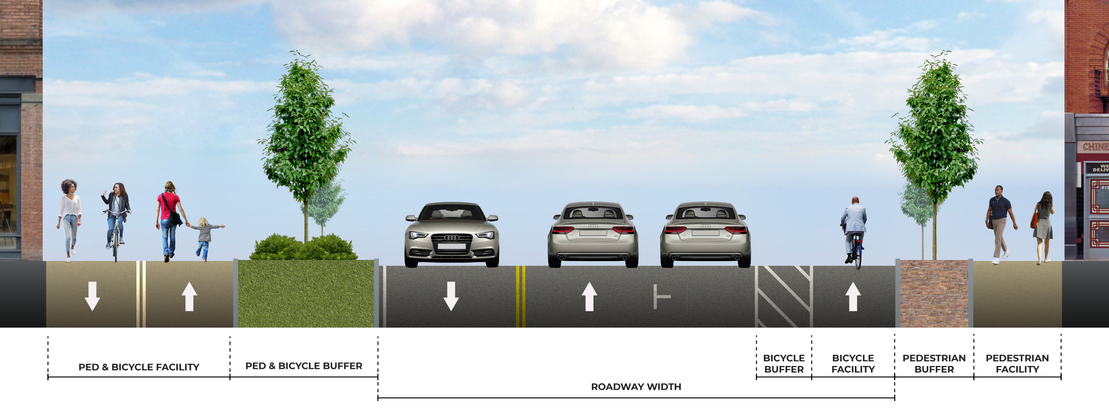
SARPET Overview: User Inputs
Users input data based on project scope
  General project components, materials, measurements
Based on inputs, tool uses predetermined background calculations to develop a cost estimate for each item
  Savvy users can edit background assumptions if desired

Slide 26
SARPET Overview: Cost Calculations
The tool’s background calculations utilize MassDOT's weighted bid prices to develop estimations
  Uses the Mean Unit Price of an item for the appropriate District
  If the Statewide Mean Unit Price is higher, the tool uses it to ensure a more conservative estimate (can be overridden)
SARPET is updated every 3 -4 months to refresh data to reflect the latest bid prices
  Always visit the SARPET website to download the latest version!
Unit prices can be overridden by a user when more accurate costs are available locally

Slide 27
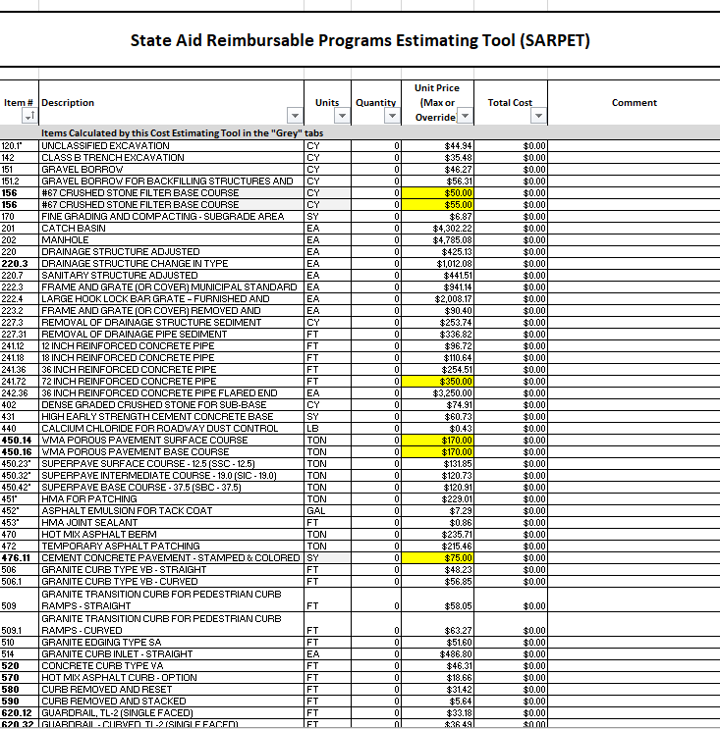
Municipal Programs: SARPET – New Municipal Tool
Provides a project summary and cost estimate
  Includes standard item numbers when available
  Aligns with MassDOT Preliminary Estimate Form
Uses MassDOT Weighted Bid Prices
  Uses District level data, statewide if none exists
    Allows for manual override of costs by user if desired
  Tool is updated with new bid prices twice annually
First-in-the-nation tool of its kind!
  Learn more on the SARPET website
Draft for Discussion Only

